Slide 1
AN EFFICIENT JOB SHARING STRATEGY FOR PRIORITIZED TASKS IN MOBILE CLOUD COMPUTING ENVIRONMENT USING ACS-JS ALGORITHM

Slide 2
Introduction
All the applications we want to use on mobile phones or tablets need higher computational capacities like memory and computation hardware (task scheduling and resource allocation).
Mobile cloud computing is as a promising task in which users can offload the computation tasks to external cloudlets from their mobile devices via internet to improve resource insufficiency of mobile devices
But how can we share all these tasks so that they can be performed effectively?

Slide 3
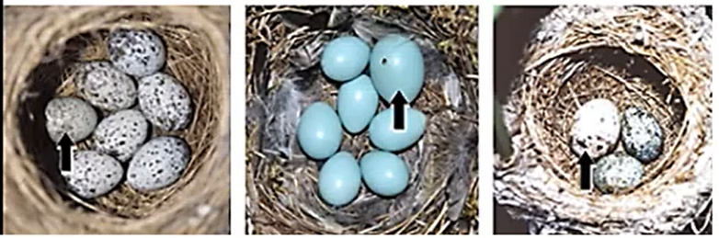
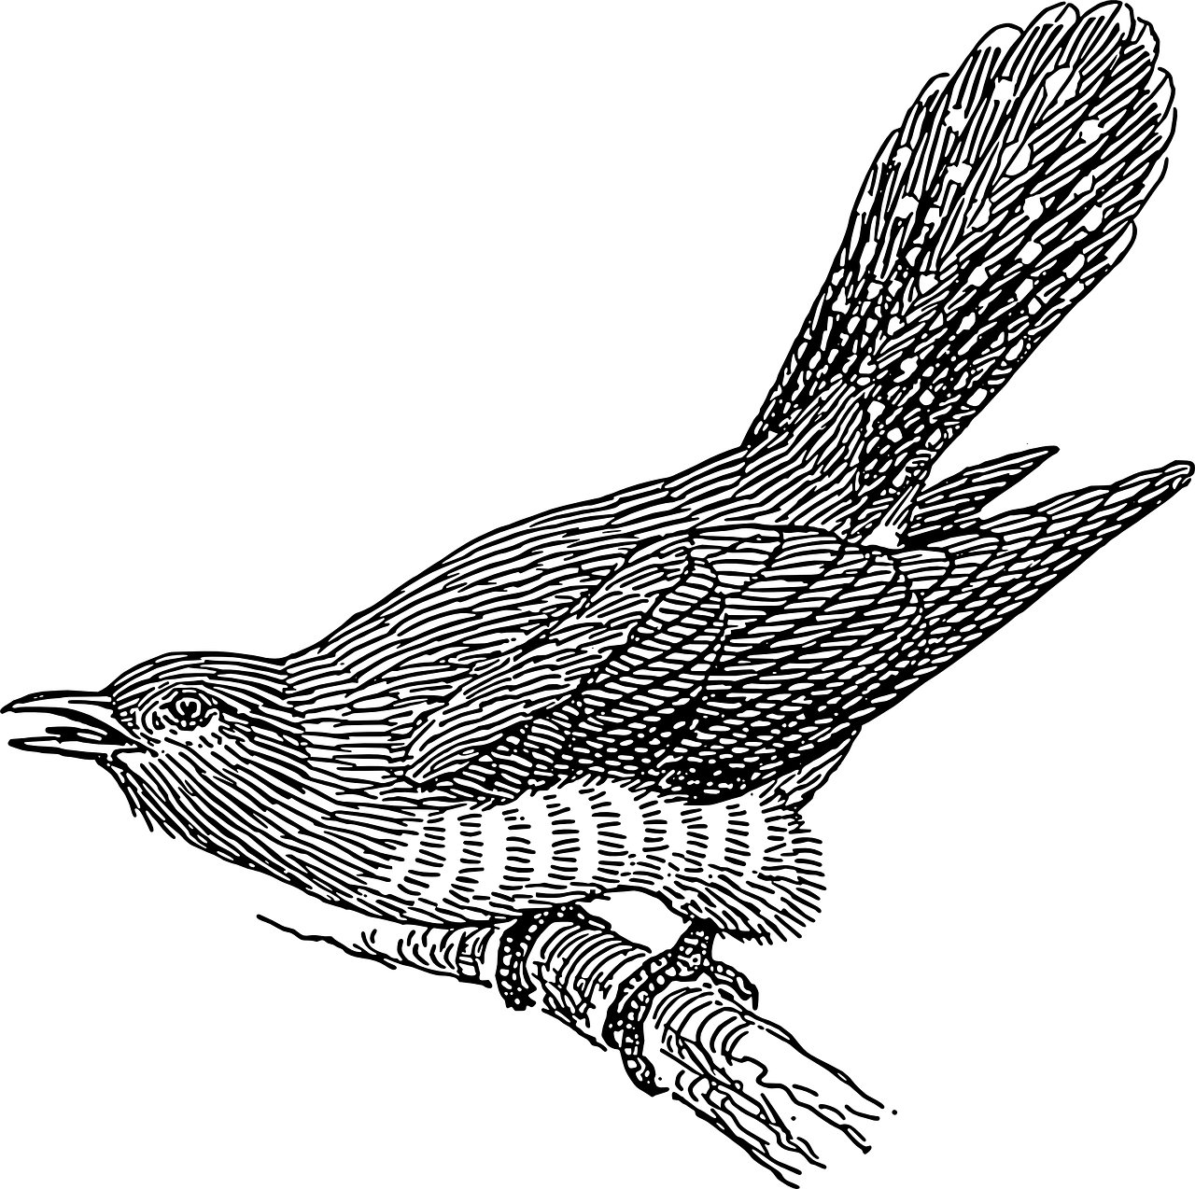
CUCKOO ALGORiTHM
-> is a Meta-Heuristic Algorithm
-> is inspired by some Cuckoo species laying their eggs in the nest of other species birds.
They lay their eggs in the nest of individuals of other species. That increase their survival and productivity.
Host Birds
Cuckoo eggs
Throw the egg away
Build new nest

Slide 4
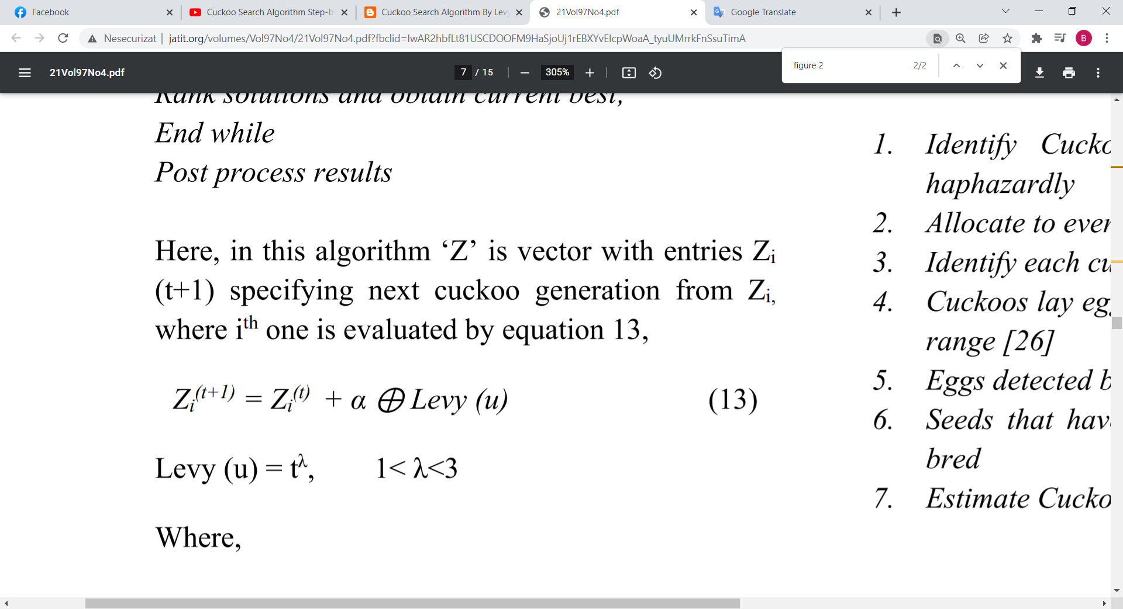
Algorithm
Objective function f(x), x=( x1, …, xd);
Initial population of ‘n’ host nests xi (I =1,2,…,n);
while (t < Maximum Generation);
Get Accelerated cuckoo (i.e. I ) randomly and produce novel solution using Lévy flights;
Compute its quality/fitness; Fi
Choose nest among n (i.e. j ) randomly;
if (Fi > Fj ),
Replace j by new solution;
end
Discard fraction (Pa) of worse nests [produce new ones at new locations through Lévy flights];
Keep best solutions (or nests with finest solutions);
Rank solutions and obtain current best;
End while
Post process results
Levy Flights

Slide 5
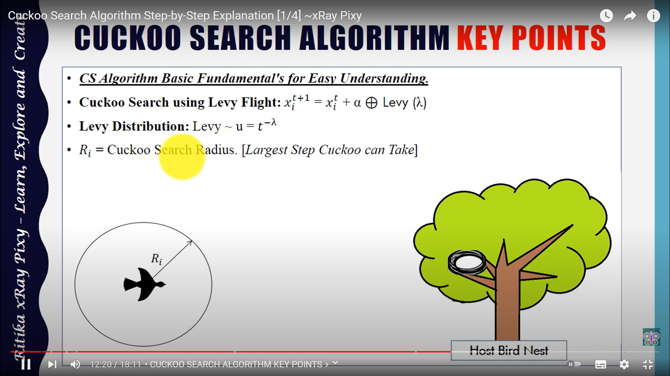
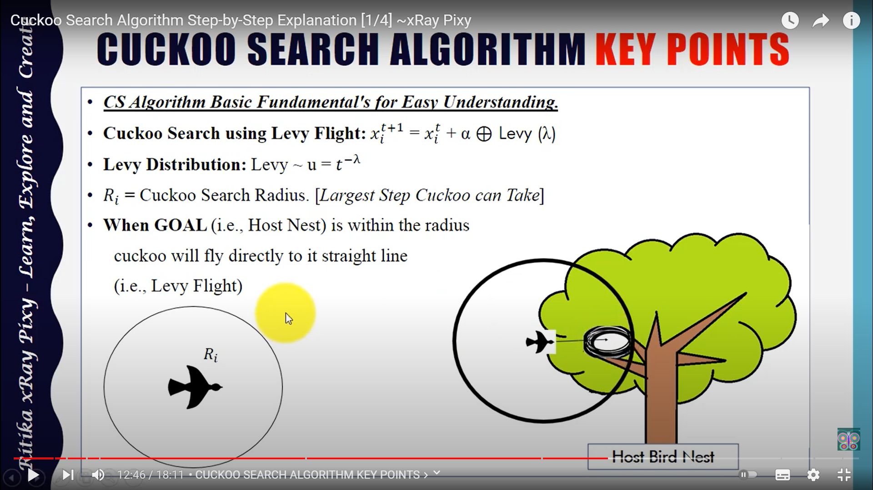

Slide 6
Accelerated Cuckoo Search Algorithm for Job Sharing
Step 1: Number of tasks/node ( )
Step 2: Job sharing ( )
Step 3: At job arrival to VM, dispatcher consults waiting queue for priority.
Step 4: If (waiting queue) ≠ ø
Dispatcher removes first VM from queue and allocates job to this specific VM.
Step 5: If (waiting queue) = ø {
If (global Resources Can Host VM), then
{Initiate new VM instance Add VM to available VM list
Deploy services to new VM }
Else {
Dispatcher directs job to randomly chosen nodes using Accelerated Cuckoo ( )
Job sharing ( ) }
Step 6: If (VM available)
{ Intra Pm ()
Find overloaded VM instance and transfer load into least loaded VM within Pm. }
Else {
Inter Pm ()
Migrate task to Pm whose average utilization is lesser than threshold within same node.}

Slide 7
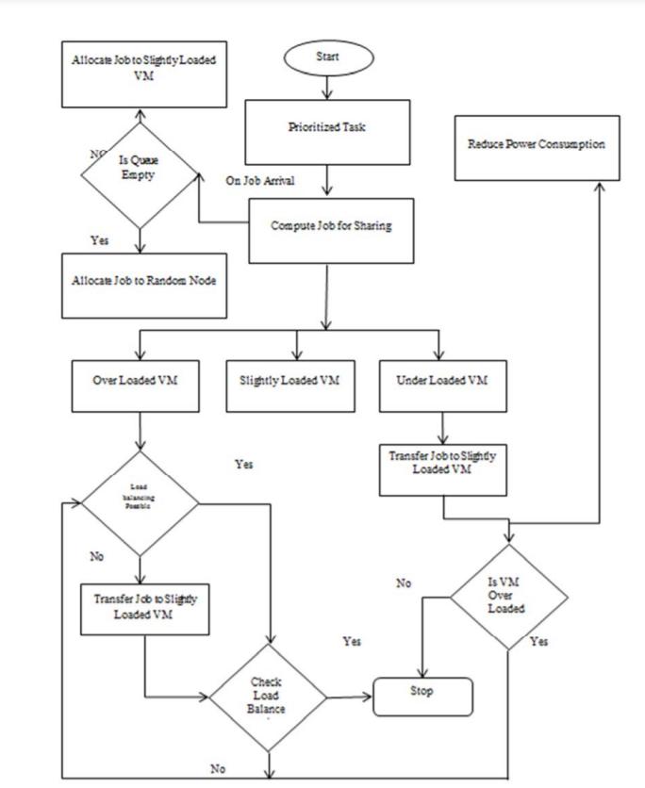
D
I
A
G
R
A
M

Slide 8
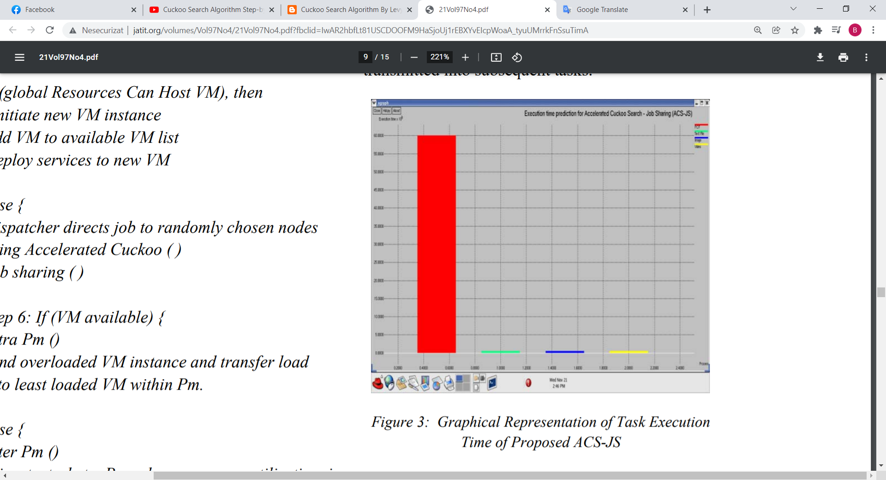
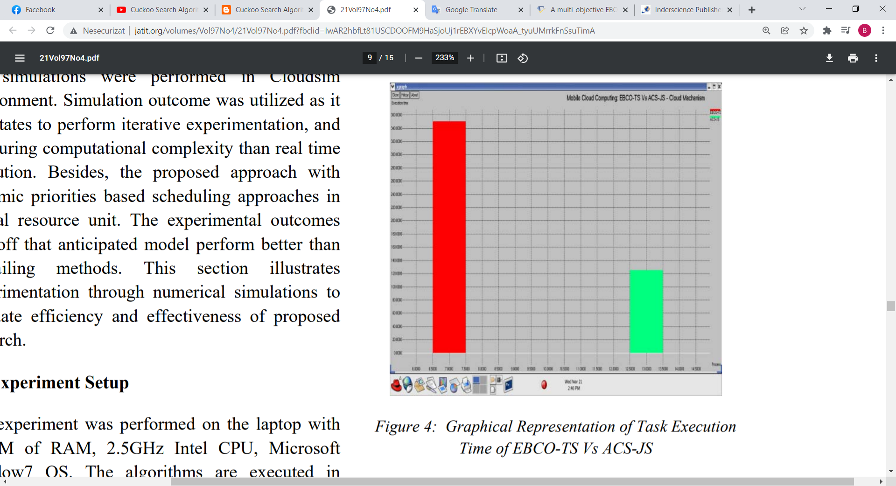
RESULTS
The experiment was performed on the laptop with 8192M of RAM, 2.5GHz Intel CPU, Microsoft Window7 OS.

